Slide 1



Name of Project:
Smart Energy Consumption Forecasting
Student ID: STU656370e43668f1701015780
Internship ID: INTERNSHIP_175683301568b724f7b9fba

Slide 2

Learning Objectives
Understand how household energy consumption behaves over time.
Learn how Machine Learning models can analyze and forecast electricity usage.
Gain exposure to data preprocessing, feature engineering, and time-series prediction.
Interpret model outputs to make smarter energy decisions.
Explore how forecasting can help reduce bills and improve energy planning.
Goal of the Project
    The main goal is to predict future electricity consumption using ML models (RF, XGBoost, and LSTM).
    Provide users with insights into usage trends and help them understand when consumption is high, medium, or low.
    Build a simple Streamlit application where users can upload data and instantly get predictions.
GOAL
Source :
www.freepik.com/

Slide 3
Tools and Technology used
Programming Language: Python
Libraries: Pandas, NumPy, Scikit-Learn, XGBoost, TensorFlow/Keras
Visualization: Matplotlib, Streamlit line charts
Application Framework: Streamlit (for building the interactive web app)
Model Storage & Handling: Joblib for saving/loading ML models
Version Control: Git and Github (Github Repo https://github.com/Mudduluru-Monisha/Smart-Energy-Consumption-Forecasting) to manage code and collaborate
Environment: Jupyter Notebook / VS Code
Hardware: Local machine for training and testing models

Slide 4
Methodology
Existing Methodology
Electricity usage is typically analyzed monthly using bill readings.
No detailed hourly or daily consumption insights.
Consumers rarely understand which appliances increase their bill.
No system to forecast future usage — only past bills are checked.
Manual tracking leads to inaccurate or delayed decision-making.
Proposed Methodology
Use historical energy data (hourly or daily) to train machine learning models.
Perform preprocessing: handling datetime, creating rolling averages, and generating lag features.
Train RF, XGBoost, and LSTM models to understand patterns and predict future usage.
Provide real-time prediction through a Streamlit app.
Help users plan consumption better and avoid unnecessary spikes.

Slide 5
Problem Statement:
“Electricity consumers do not have a clear, real-time understanding of their power usage, and most households only receive monthly readings without insights into when and why consumption increases. This makes it difficult to control bills, detect unusual usage patterns, or plan consumption. The challenge is to build a system that can analyze past consumption data and accurately forecast future usage.”

Slide 6
Solution:
Collect historical electricity consumption data with timestamps.
Preprocess the dataset: convert datetime, generate features, handle missing values.
Train three ML models — Random Forest, XGBoost, and LSTM — to compare prediction accuracy.
Build a user-friendly Streamlit app where users upload their CSV and get:
Future electricity usage predictions
Model comparison graphs
Insights on high, medium, and low consumption
Allow users to choose “next hours” or “next day” predictions (future enhancement).

Slide 7
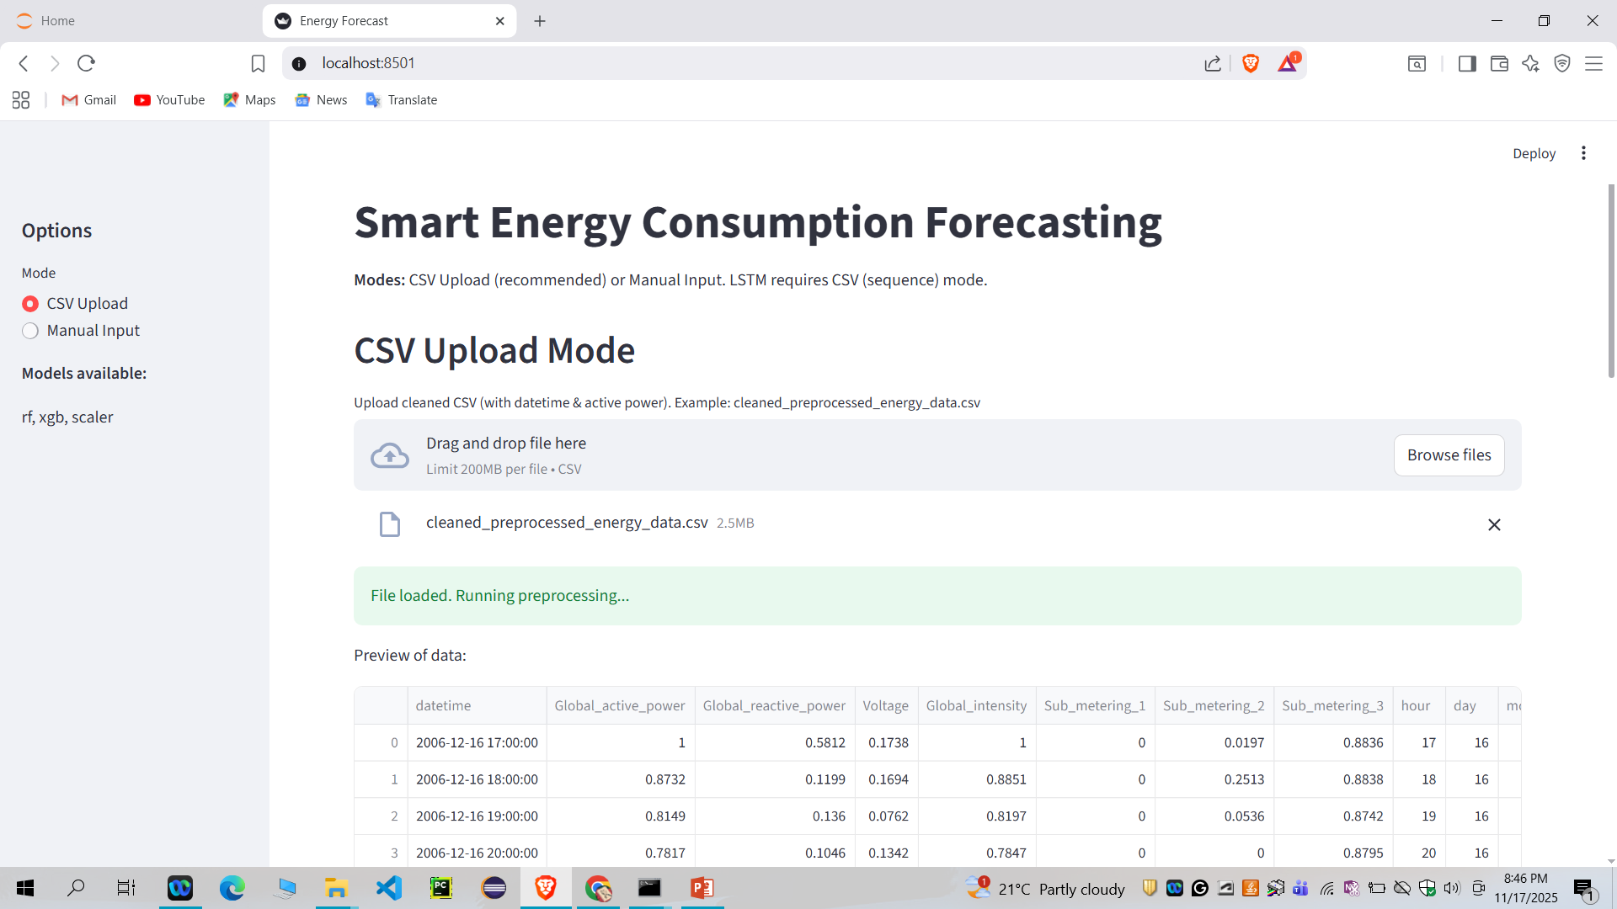
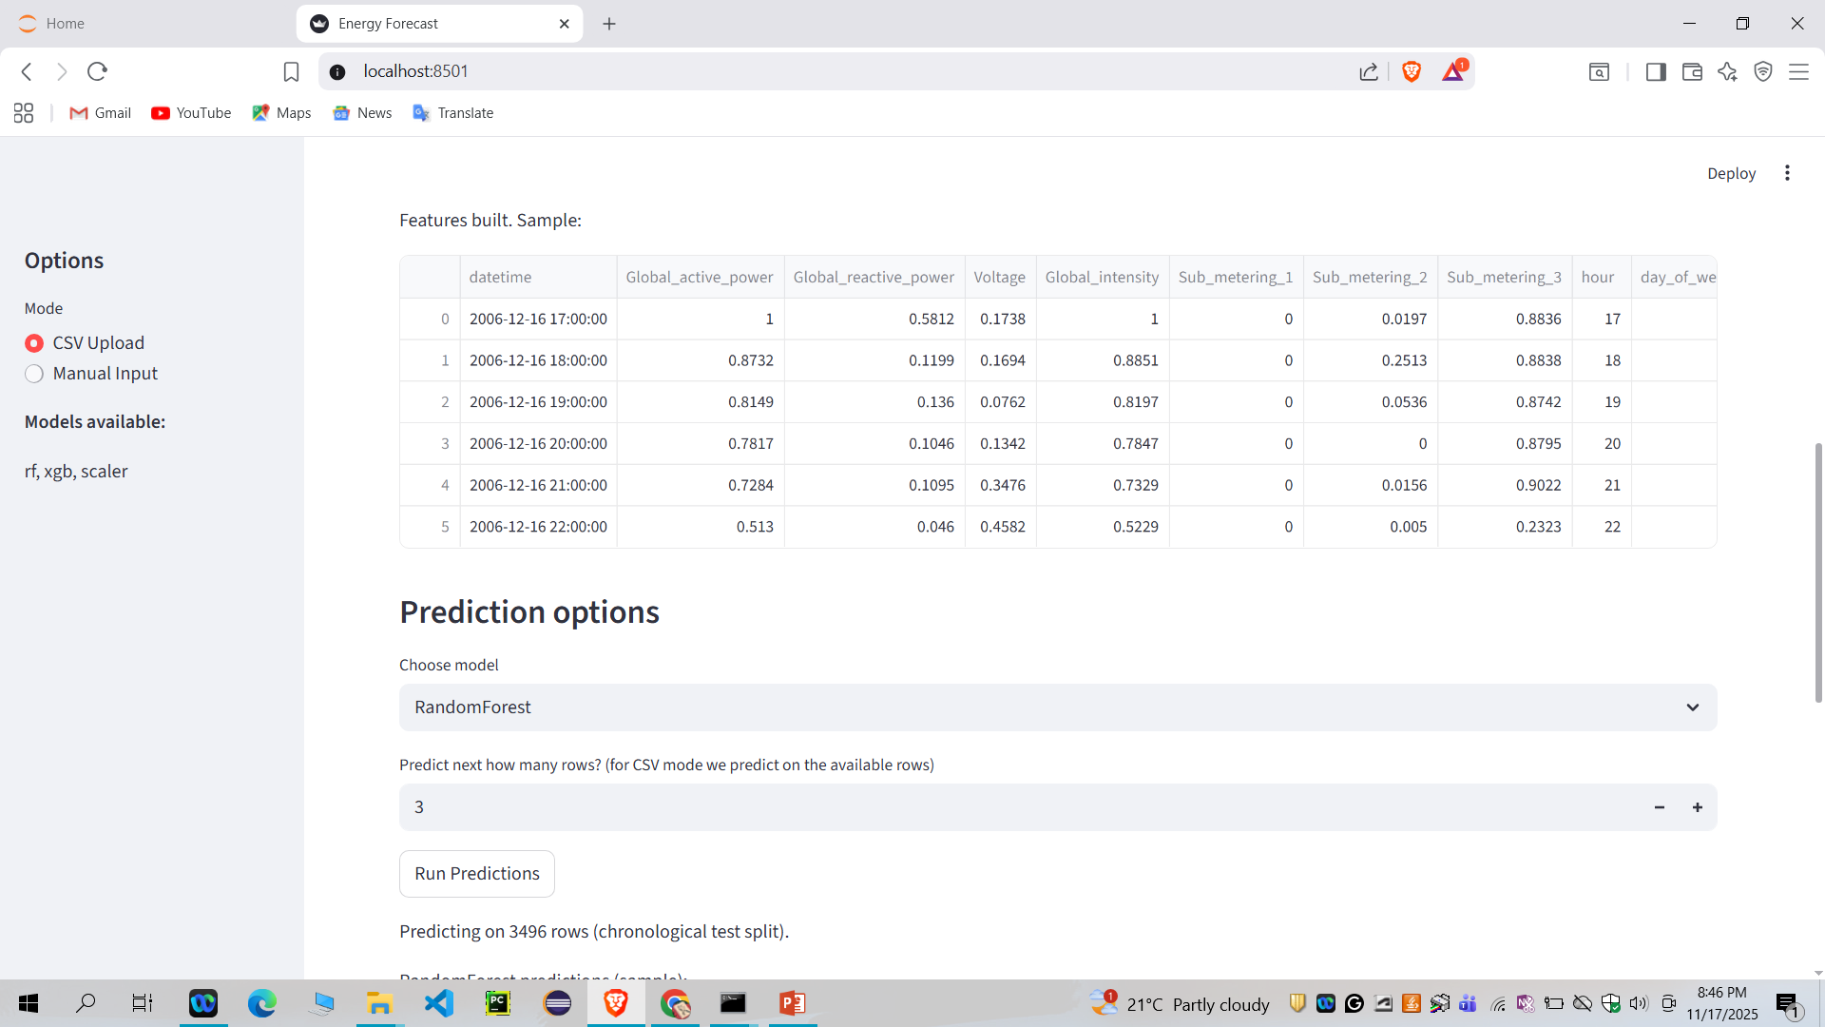
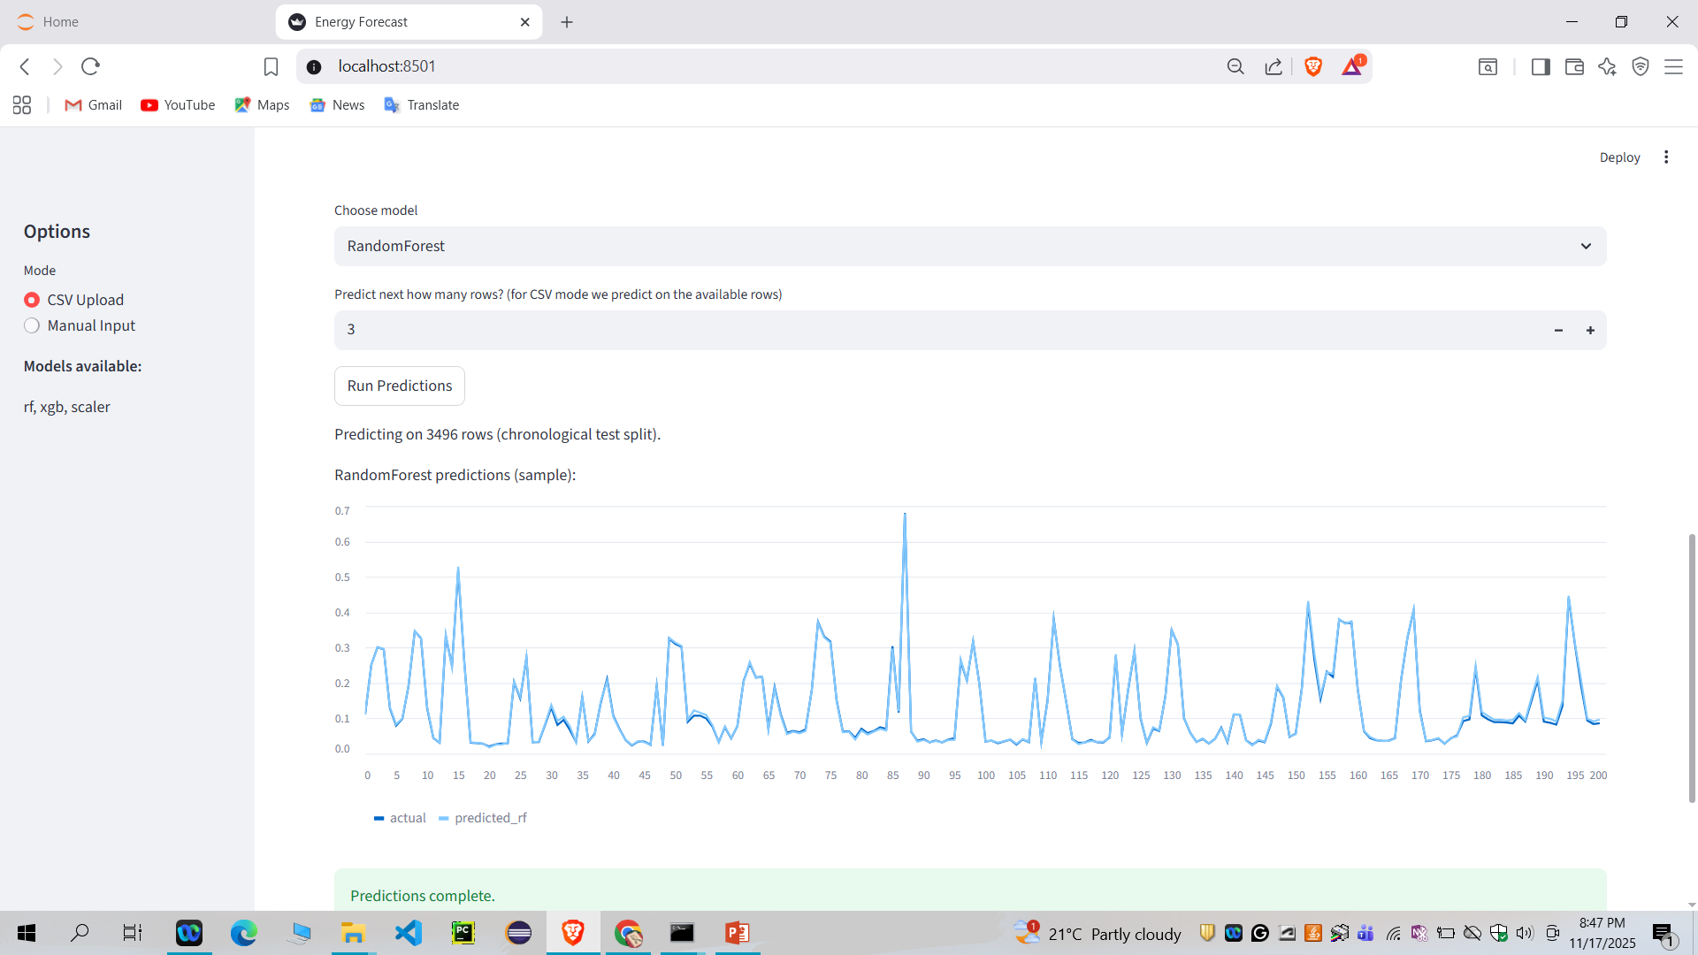
Screenshot of Output:

Slide 8
Conclusion:
The project successfully demonstrates how machine learning can forecast electricity consumption. Models like RF, XGBoost, and LSTM provide accurate predictions based on historical data. The Streamlit interface makes the system easy for users to interact with. Forecasting helps users plan usage, avoid heavy load spikes, and reduce electricity bills. This project can be extended with real-time smart meters, appliance-level monitoring, and mobile app integration.

